Slide 1


WELCOME TO
WARTON
Prospective Parent Tour
Reception September 2026
SF

Slide 2

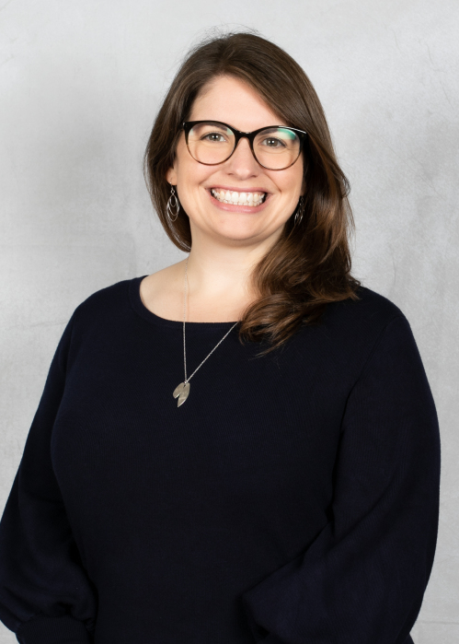
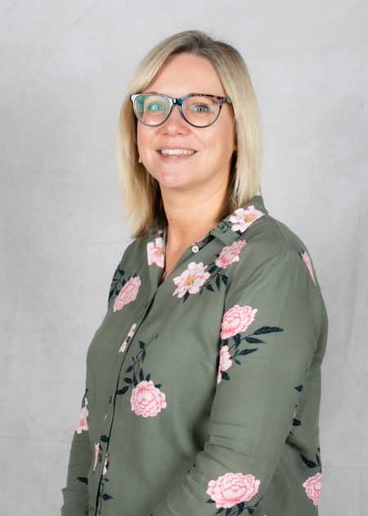

WHO WE ARE!
Miss Susan Friend & Mrs Rachel Sage
Miss Susan Friend
Head Teacher
Mrs Rachel Sage
Early Years Leader
SENCO
SF

Slide 3

A PART OF...
Birmingham Diocese Multi-Academy Trust
CEO : Tim Boyes
19 schools
5 in Warwickshire
SF

Slide 4





VISION
- Church School
-Reverend Joanne
-Church visits (& visits to other places of worship!)
SF

Slide 5

VALUES
One School Rule
“We always do our best to
live our values”
Values Days
SF

Slide 6

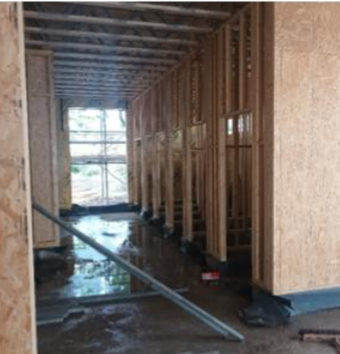
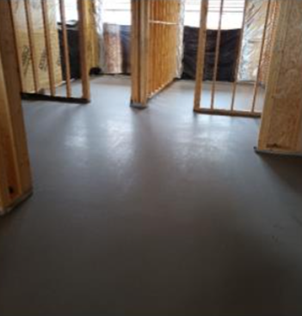

OUR GROWING SCHOOL...
  Expansion project started in September 2024
  We are awaiting completion of two new classrooms, offices and toilets
  Year 6 in Portakabin and Year 5 in smaller classroom until December
  One form entry in new classes from January 2026
SF

Slide 7





SCHOOL STRUCTURE
One Form Entry
Acorns Nursery - from 2 YO
Willow Class - Reception
Sycamore Class - Year 1
Beech Class - Year 2
Maple Class - Year 3
Elm Class - Year 4
Rowan Class - Year 5
Oak Class - Year 6
SF

Slide 8






DAILY SCHEDULE
Monday
Tuesday
Wednesday
Thursday
Friday
  Phonics
  English
  Maths
  Collective Worship
  Storytime
  Phonics
  English
  Maths
  Collective Worship
  Storytime
  History
  Phonics
  English
  Maths
  Collective Worship
  Storytime
  PE
  Phonics
  English
  Maths
  Collective Worship
  Storytime
  RE
  Phonics
  English
  Maths
  Collective Worship
  Storytime
RS

Slide 9



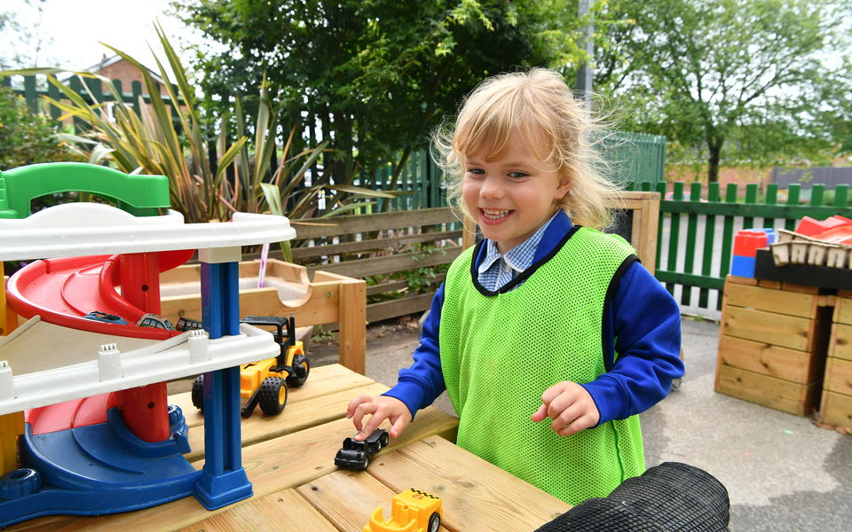

CONTINUOUS PROVISION
  learning through play
  learning opportunities are a mix between planned activities and child led
  promotes independent exploration and discovery
  is indoor and outdoor whatever the weather!
RS

Slide 10
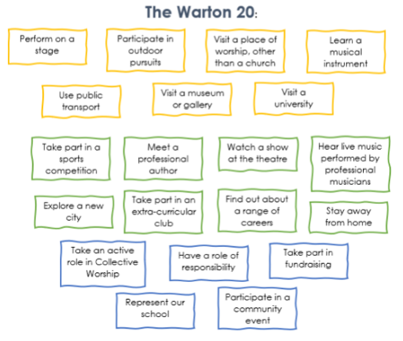
WARTON 20
RS

Slide 11
DIVERSITY &INCLUSION
-Global Curriculum
-Trips and Visits e.g. to the Mosque, Gurdwara and Baptist Church
-Visitors to school such as ‘Stories of Home’ and link to Kimilili
-City visits including trips into Birmingham
-Book challenge
RS

Slide 12
TRANSITION
-When children transition from our nursery their new teacher will go to nursery regularly to get to know the children and share stories and activities.
-All children are invited to come in to school for our ‘Moving Up Day’. This is 9-11.30 in July (8th July) and will be a time to see their new teacher and their new classroom!
RS

Slide 13
INDUCTION- FOR PARENTS!
Welcome letters following offer day – April / May 2026
Welcome to Reception Meeting - June 2026
Home Visits - July 2026
Phonics Meeting - September 2026
Church Visit - September 2026
RS

Slide 14
INDUCTION (FOR CHILDREN)
-We always have a short, staggered start for pupils to support their induction
Wednesday 2nd September - Group 1: 9-11 / Group 2: 1-3
Thursday 3rd September - All pupils from 8.40-1pm
Friday 4th September - All pupils 8.40-3.15
RS

Slide 15

BUDDIES
  Every Reception child has a year 6 buddy who helps them at playtimes, through collective worship and in activities across the year
RS

Slide 16

EXTRA CURRICULAR
Sports
Trips
Clubs
Last year we took part in 18 competitions with other schools.
This ranged from athletics to football, netball to gymnastics.
In the big county end of year event we came 3rd !
Annual theatre trip
At least one other trip each year
Local visits in addition
Visitors to school
Camp in Year 6!
-25 after school clubs across the year
-3.15-4.15pm
-nominal cost (currently £10 for 6 sessions)
-cadets, craft, sewing, football, gardening
SF

Slide 17
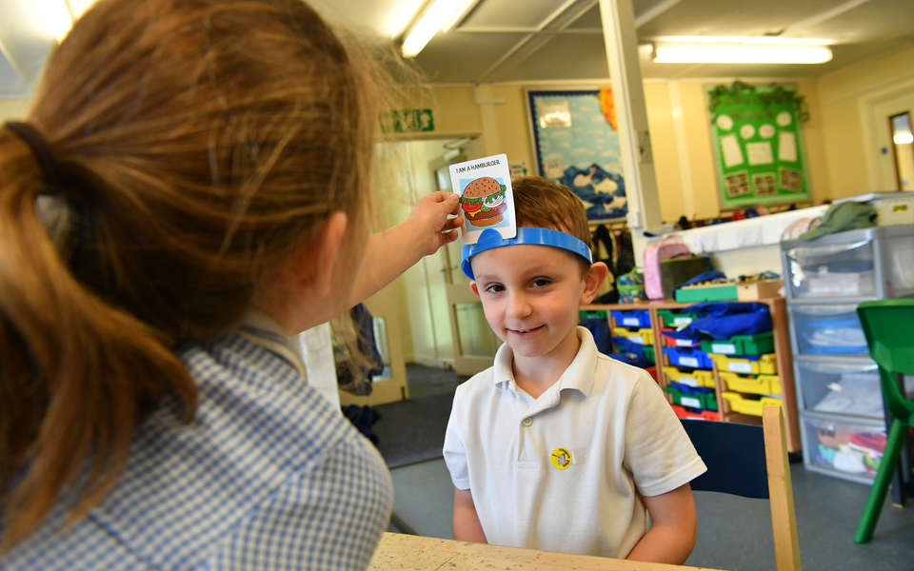
WRAP AROUND
  Breakfast Club 7.30-8.45
  After School 3.15-5pm
These sessions are paid for - see website for current costs
They are run by school - our trained staff!
SF

Slide 18

How to Apply
Warwickshire School Admissions
Apply online via Warwickshire School Admissions
SF

Slide 19
ANY QUESTIONS?
SF

