Slide 1

SEND School Local SEND School Local Offer
Information Report
2025-26
Warton Nethersole’s CE Primary School

Slide 2

You will find information on:
Who the Inclusion team are
How we communicate with you about your child
Which agencies might become involved with your child
How we ensure the necessary people know about your child’s needs
What happens when your child moves school

Slide 3
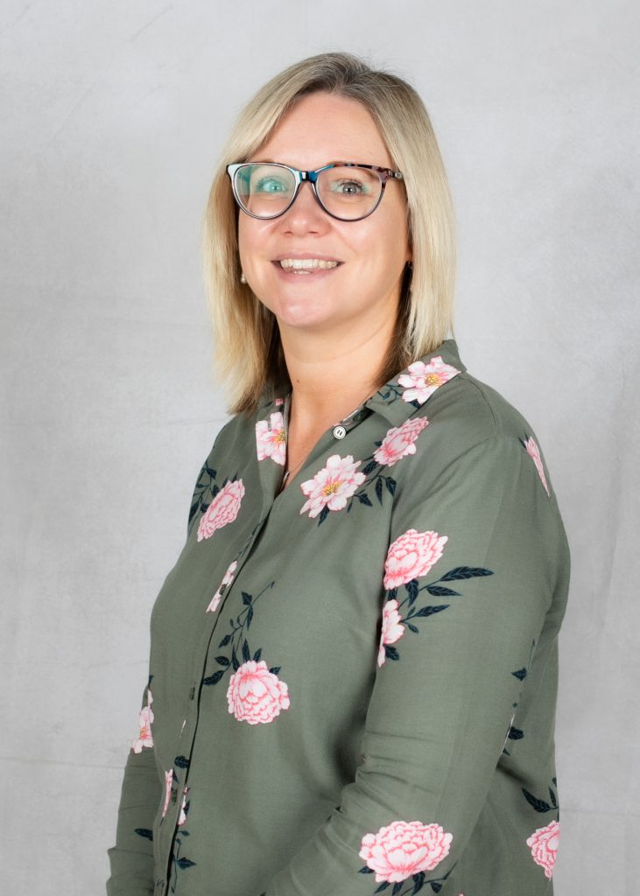
SENCO- Mrs Rachel Sage
My name is Mrs Sage and I am the School SENCO and Assistant Headteacher at Warton Nethersole’s CE Primary School.
I work with children, teachers, parents and agencies to ensure that our pupils’ needs are met.
You can contact me on email at r.sage@warton.bdmat.org.uk

Slide 4
What happens if there is a concern about progress?
If you have a concern about your child, we always encourage you to speak to your child’s class teacher first.
Assess
Plan
Do
Review
Concerns from teachers/
parents about progress are made and recorded.
Teachers and parents will meet with the SENCO to discuss the child and produce a support plan.
Provision is given to the child.
Input from the teacher, support staff,
pupil and SENCO.
If there are still concerns then SENCO will arrange for external support and agencies to become involved.

Slide 5
How will the School let me know if they have any concerns?
If school thinks your child needs extra support, we will always talk to you about this.
In the first instance your child’s class teacher will liaise with you by arranging a meeting in school to discuss progress.
There are scheduled Parents Evenings in the Autumn and Spring term which provide an opportunity to discuss any concerns with their learning.
The School’s graduated approach to meeting learning difficulties has been designed so that parent/carers will be informed if their child has been identified as requiring additional support.

Slide 6
How will the School let me know if they have any concerns?
Termly SEN review meetings for children with special educational needs and /or disabilities will highlight any concerns with the progress your child is making towards their targets.
The ‘Open Door’ policy at Warton Nethersole’s means that we encourage parents/carers to make contact with the school whenever you have a concern yourselves about your child’s learning.
The school provides a central point of contact for you through the SENCO who coordinates the support your child receives.

Slide 7
Support from external agencies
Warton Nethersole’s works with lots of external agencies to help identify specific needs. These are:
Educational Psychologist Service- Warwickshire and Private
Educational Welfare Officer- Jo Sierzega
School Link SAL Therapist- James Potter
Warwickshire Specialist Teaching Service (STS)
Social Services
School Nurse
Local Health Visiting team
RISE- Child and Adolescent Mental Health Services ( CAMHS)

Slide 8
Parental involvement in their child’s learning
Our school has an open door policy, ensuring we are always approachable so you, as parents and carers feel involved in the education of your child. This is done in a variety of ways including:
The school holds a Parents Evening once a term (Autumn & Spring) for you to meet your child’s class teacher and look at their work.
In addition, IEP / ISP / EHC reviews are held four times per year.
There can be more regular meetings with your child’s class teacher, support staff and SENCO when necessary.
Curriculum overviews are published on our school website.
Reading record books will be used for written communication between home and school.
Information on the school website
Open mornings/afternoons

Slide 9
Individual plans
The SENCO, Mrs Sage, will make sure that all necessary school staff are aware of your child’s needs and worries.
If your child has been placed on our SEN register, an Individual Education Plan or an Individual Support Plan will be written with the teacher and shared with you and your child.
If your child has medical needs, a care plan will be written and shared with you.
All staff have access to these plans. The plans identify how your child should be helped to succeed and make progress. These plans will be reviewed regularly.

Slide 10
Provision at Warton Nethersole’s
In our school we make provision for pupils with all types of Special Educational Needs and Disabilities.
All children in school have support within lessons through adaptative and quality first teaching. This means that learning activities are planned according to the level the child is working at , so that they make continuous progress from their individual starting points.
Warton Nethersole’s is a fully accessible school. As a school, we would always make adjustments to ensure that all children are fully included.

Slide 11
Provision at Warton Nethersole’s
Specialist outside agency involvement, support from a TA, 1:1 teaching.
Targeted interventions to enable children to close the gaps
Universal Needs- Adaptive Quality First Teaching for all pupils at Warton Nethersole’s

Slide 12
Four Areas of Need
Communication & Interaction Autistic Spectrum Disorder (ASD) Speech, Language and Communication Needs (SLCN) | Cognition & Learning Moderate Learning Difficulty (MLD) Profound and Multiple Learning Difficulty (PMLD) Severe Learning Difficulty (SLD) Specific Learning Difficulty (SpLD) Dyscalculia, Dysgraphia, Dyslexia & Dyspraxia.
Social, Emotional & Mental Health Difficulties Adjustment Disorders Attention deficit hyperactivity disorder (ADHD) Anxiety Disorders Obsessive-Compulsive Disorder ('OCD’) Attachment and Trauma | Sensory and/or Physical Hearing Impairment (HI) Visual Impairment (VI) Multi-Sensory Impairment (MSI) Physical Disability (PD) Sensory Processing

Slide 13
Quality First Teaching to meet all needs
Communication & Interaction Word mats/Key vocabulary Displays, visual reminders Modelling examples Speaking and listening time The Oracy Project Links are made to previous learning Verbal instructions clear, one at a time, opportunity for pupils to repeat Key words highlighted Partner Talk Good listening prompts | Cognition & Learning Writing frames Differentiated success criteria Coloured overlays Different pens Sound mats Multi-sensory learning games Maths- number squares,lines,vocab, equipment Commonly needed information displayed- days of the week, months of the year Task management prompts Spelling aids-word mats,dictionaires ,spell checkers Phonics and maths catch-up sessions
Social, Emotional & Mental Health Difficulties Achievable targets Being consistent Differentiated success criteria Time to talk to the teacher House points, certificates, HT stickers Quiet area in the class Independent workstations Visual timetables Now/Next prompts Nurture in the classroom Access to Play Therapist Beacon Behaviour Support | Sensory and/or Physical Sloping boards Different pens/pencils with grips Spring loaded scissors Sitting arrangements in the class- good posture ,footrests, seat wedges etc. Quiet area in the classroom Dough Disco/Gym interventions Health Care Plans Risk assessments for physical needs Sensory boxes Regular rest / movement breaks Equipment changes and support Sensory resources including fiddles and chair bands

Slide 14
Support available for children with SEND at Warton Nethersole’s
Our teachers adapt what they are teaching or the way they are teaching to help children learn and progress in the best way possible.
Extra support can be given in a small group by the teacher or a teaching assistant. This kind of support is provided in the classroom.
Extra support can also be given to children by an adult for short times during the day, or over a week to support them to learn specific skills.
Children with special educational needs and /or disabilities will often have individual education plan targets that show what they need help with.
The school will seek advice from external professionals if required.

Slide 15
Staff Training for SEND pupils
In line with the Code of Practice, all staff at Warton Nethersole’s are involved in supporting pupils with special educational needs, disabilities and medical needs, so we make sure that staff have training to help them do this.
Our SENCO and SLT provide all staff in school with specialist support, training and advice.
We also receive focussed CPD from Warwickshire Local Authority and from BDMAT as well as Beacon Support.

Slide 16
How will teaching be adapted for my child with SEN?
Class teachers plan lessons according to the specific needs of all groups of children in their class, and will ensure that your child’s needs are met.
Specially trained staff will provide support through one to one or small group work.
Specific resources and strategies will be used to support your child to enable them to make continuous provision from their individual starting point.
Planning and teaching will be adapted on a daily basis, if needed , to meet your child’s learning needs.

Slide 17
How do we involve children in decisions?
We aim for all children in our school to have a voice about what happens in their school. For children with Special Educational Needs we use a variety of strategies to support this including:
Involving the children in the IEP process through them sharing their strengths and ambitions
Using Self and Peer assessment within the classroom
Ensuring the children have opportunities to work with a range of their peers
Ensuring the children have a designated adult- key worker to go to if they need help educationally, socially or emotionally
Providing opportunities to become involved in the School Council
Using personalised behaviour charts where appropriate
Providing visual timetables in all classrooms
Providing prompt cards to enable the children to experience greater independence

Slide 18
What support do we offer parents of children with SEN?
As part of our open-door policy the class teacher is regularly available to discuss your child's progress or any concerns. Please either send a message on Tapestry or email the school office.
The SENCO or Headteacher are available to meet with you by prior appointment to discuss your child’s progress or any concerns/worries you may have.
Your child’s provision will be reviewed with your involvement each term.
Homework (such as spellings) will be adjusted to meet your child’s individual needs.

Slide 19
Transition
We aim to make times of transition as easy as possible for the children in our school.
If appropriate, when starting at our school we:
Meet with the child and their parents/carers to talk about their needs and answer any questions about our school.
When children are starting in Reception we carry out home visits and visits to Nursery/Pre School settings.
Read reports from people who have worked with the child.
Arrange visits to our school so the child gets to experience it before they start properly.
Based on needs, when moving to a new year group we:
Introduce the child to their new teacher and support staff during transition morning. Children with additional needs have the opportunity for further visits to see new teachers and classrooms as and when needed.
Hold transition meetings between teachers to pass on key information and targets that will ensure a smooth transition can take place.

Slide 20
A partnership approach
If interventions are successful child remains on non-IEP pathway.
Child receives a diagnosis or intervention from external agency such as SALT.
Assessments / interventions are carried out to find out the specific needs of the child.
Possible involvement of outside agency.
If interventions occur and concerns are still there, targets to address pupil needs are written by SENCO and class teacher, then shared parents and pupils. Resources and teaching approaches are identified. Child is added to SEN register.
Parents or teachers raise a concern about the progress of a child.
IEP is written. Appropriate support/
interventions are included and progress recorded.
Concerns are addressed.
Progress to be monitored continuously.
Outcomes are assessed and reviewed with parents/carers and the child.

Slide 21
Governing Body- LAB involvement
Our school SEN Local Academy Board Member is:
Mrs Linda Buckingham
The Local Academy Board work together to :
Challenge the Headteacher and SENCO regarding the provision for and the progress of children with any additional needs.
Complete pupil voice and book scrutiny monitoring for children with additional needs, to ensure the provision is enabling them to make the progress they are capable of.

Slide 22
What can parents / carers do if they are not happy?
If you have a complaint about the school’s provision for your child which cannot be resolved with the class teacher or the SENCO, please contact the Headteacher and we will do everything we can to address the issue.

Slide 23
Warwickshire Local Offer
By law, Warwickshire Local Authority has to provide information on a website detailing all services available in Warwickshire for children with Special Educational Needs and Disabilities. This information is called The Local Offer and can
be found at:
www.warwickshire.gov.uk/send

